Slide 1
Software framework University of Kurdistan

Slide 2
Agenda
Introduction
Frameworks & Libraries
Benefits & Issues
Properties
Real-world examples
Conclusion
2

Slide 3
Introduction
Software framework
A framework is a reusable semi-complete application that can be specialized to produce custom applications.
In short , a framework is a set of classes and libraries.
3

Slide 4
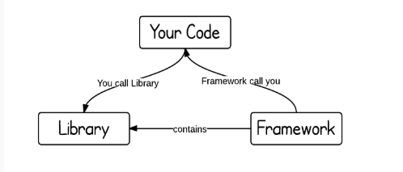
Frameworks & Libraries
4

Slide 5
Framework Goals
Reuse : code, design, and documentation.
Simplify software development.
Reduce code writing.
Allow inexperienced designers and programmers to develop good software.
Use the knowledge and experience of expert designers and programmers.
5

Slide 6
Framework Benefits
Code and design reuse.
Programmers are forced to write reusable software.
Improvement of software quality and developer productivity.
6

Slide 7
Main Issues
Learning curve.
Framework developers must be domain experts.
Framework evolution is complex.
7

Slide 8
Properties
Basic Properties
Modularity
Reusability
Extensibility
Non-modifiable code
8

Slide 9
Frameworks Category
Web Application Frameworks
Application Frameworks
Mobile Apps Frameworks
9

Slide 10
Real-world Examples
Web Application Frameworks
Designed to support the development of dynamic websites, web applications and web services.
10

Slide 11
Web Application Frameworks
AngularJS (open source, java script, single-page)
Laravel (open source, php , web apps, MVC)
ReactJS(java script library, UI, single-page web apps, facebook ,Instagram)
NodeJS(java script, server-side)
Ruby on rails (server-side, Ruby)
Symfony (php)
ASP.NET(server-side, web service, dynamic web pages)
11

Slide 12
Application Frameworks
Implement the standard structure of an application.
MVC (Model View Controller)
MFC (Microsoft Foundation Classes)
MacZoop (for macintosh)
Coca on mac
12

Slide 13
Mobile Apps Frameworks
Phone Gap (java script & HTML5, Apache)
React native (HTML & CSS & Java script)
Ionic framework(open source sdk, java script)
Mobile Angular UI(bootstrap & Angular)
13

Slide 14
conclusion
Framework Main Characteristics
Inversion of control : the framework controls the application and not the opposite.
14

Slide 15
Thanks!
Any questions?

