Slide 1
Java Script
Farid Mohammadi
University of Kurdistan

Slide 2
Contents
Introduction
Data
Primitive Operations
Control flow and error handling
Data Control
Storage Management
Operating Environment
Modern java script

Slide 3
Introduction
Java Script
  Releas in May 1995 by Brendan Eich
  High-level, interpreted programming language
  Event-driven, functional, and imperative (including object-oriented)
  Has an API for working with text, arrays, dates, regular expressions, and basic manipulation of the DOM

Slide 4
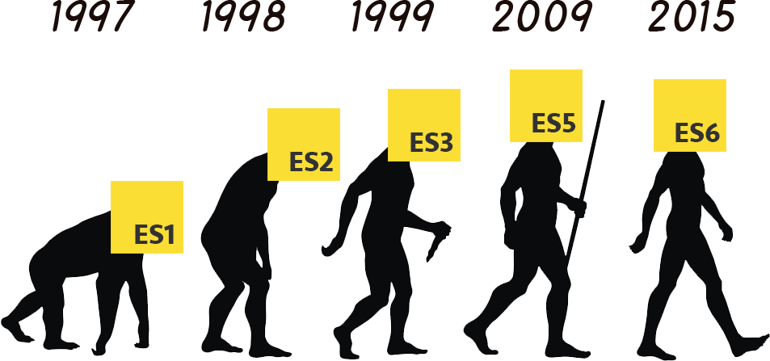
ECMA Script

Slide 5
ES6 reserved keywords
await | break | case | catch | class | continue | debugger
default | delete | do | else | export | extends | finally
for | function | if | import | in | instanceof | new
return | super | switch | this | throw | try | typedef
var | void | while | with | yield

Slide 6
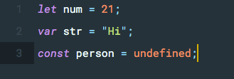
Data
Undefined
Null
Boolean
String
Number
Object

Slide 7
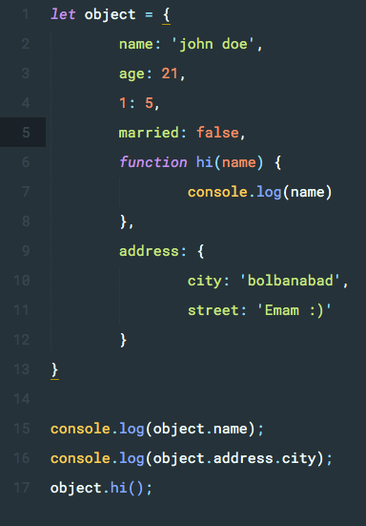
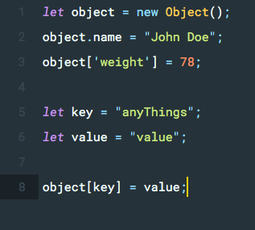
Data

Slide 8
Primitive Operations
Arithmetic operators
Comparison Operators
Logical Operators
Bitwise Operators
Assignment Operators
Miscellaneous operators

Slide 9
Arithmetic operators
Operator | Meaning
+ | Add
- | Subtract
-expr | Unary minus, also known as negation (reverse the sign of the expression)
* | Multiply
/ | Divide
% | Remainder of an integer division
++ | Increases an integer value by one
-- | Decreases an integer value by one

Slide 10
Comparison Operators
Operator | Meaning
== | Equal
===
!= | Not Equal
> | Greater than
< | Less than
>= | Greater than or equal to
<= | Less than or equal to

Slide 11
Logical Operators
Operator | Meaning
&& | Logical AND
|| | Logical OR
! | Logical NOT

Slide 12
Bitwise Operators
Operator | Meaning
& | BitWise AND
| | BitWise OR
^ | Bitwise XOR
~ | Bitwise Not
<< | Left Shift
>> | Right Shift
>>> | Right shift with Zero

Slide 13
Assignment Operators
= | /= | ^=
+= | %= | |=
−= | <<= | &=
*= | >>= | >>>=

Slide 14
Miscellaneous Operator
Operator | Name | Meaning
() | Function application | Represents a function call
[] | Object access | Refers to the value at the specified index in the object
. | Member access | Refers to a property of an expression; example: foo.bar selects property bar from expression foo
? | Conditional member access | If Condition is true? Then value X : Otherwise value Y

Slide 15
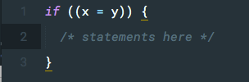
Control flow and error handling
Control flow
  if and else
  switch and case
Falsy values
  false
  undefined
  null
  0
  NaN
  the empty string ("")

Slide 16
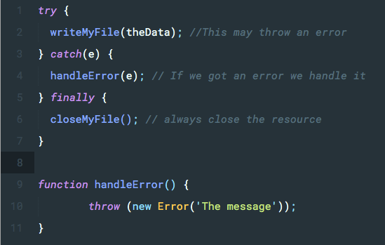
Control flow and error handling
Error handling
  throw expression
  try...catch statement

Slide 17
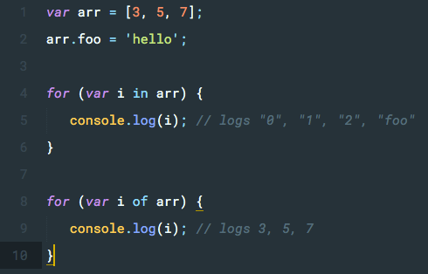
Loops and iteration
for statement
do...while statement
while statement
labeled statement
break statement
continue statement
for...in statement
for...of statement

Slide 18
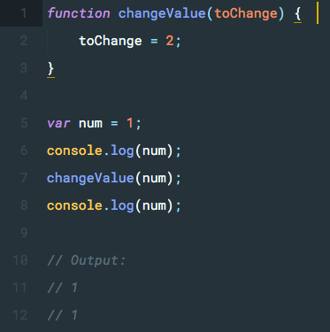
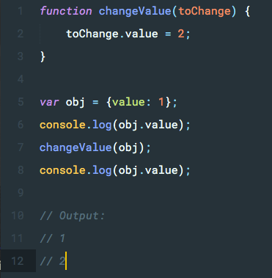
Call by value vs Call by reference

Slide 19
Call by value vs Call by reference
primitives (Number, String, etc) are always pass-by-value
Javascript is pass-by-reference for objects

Slide 20

Dynamic type checking vs static
Dynamic type checking
Use static type checking with flow

Slide 21
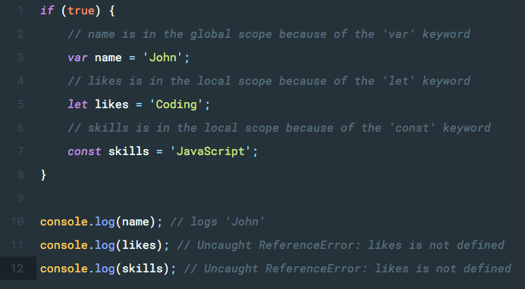
Scope
globally-scoped variable
Local scope
Automatically Global

Slide 22
Memory Management
Low-level languages, like C, have low-level memory management primitives like malloc() and free().
JavaScript values are allocated when things (objects, strings, etc.) are created and "automatically" freed when they are not used anymore. The latter process is called garbage collection.

Slide 23
Standard built-in objects
Object
  Object.length
  Object.assign()
  Object.values()
  …
Number
  Number.MAX_VALUE
  Number.NaN
  Number.isNaN()
  Number.parseInt()
  …

Slide 24
Standard built-in objects
Math
  Math.PI
  Math.sin(1.56)
  Math.abs()
  …
String
  indexOf(), lastIndexOf()
  Slice()
  Trim()
  Substring(), substr()
  …

Slide 25

Indexed collections
Array methods
  concat()
  join(delimiter = ',’)
  push()
  reverse()

Slide 26
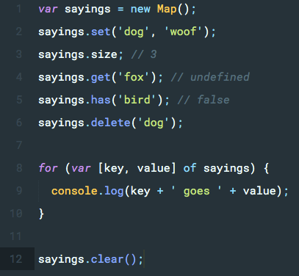
Keyed collections
Map

Slide 27
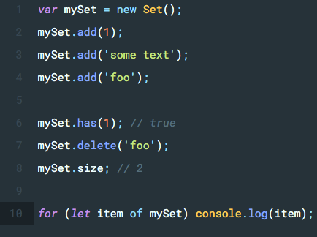
Keyed collections
Set

Slide 28
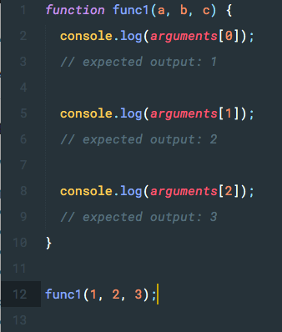
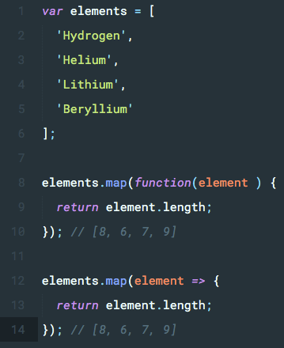
Functions

Slide 29
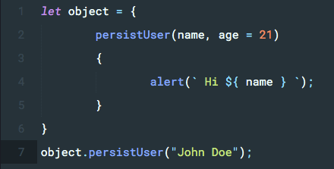
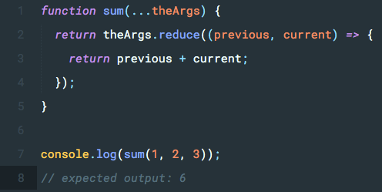
Functions

Slide 30
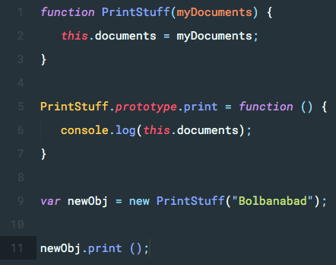
Prototype

Slide 31
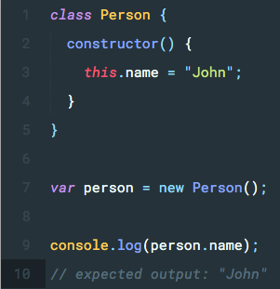
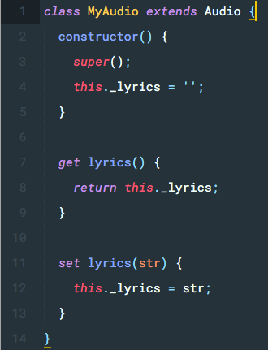
Classes

Slide 32
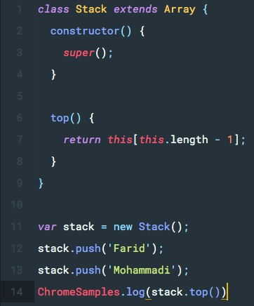
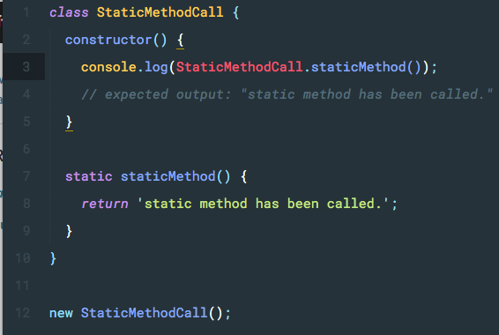
Classes

Slide 33


Modern Java script

Slide 34

Modern Java script

Slide 35



Modern Java script

Slide 36
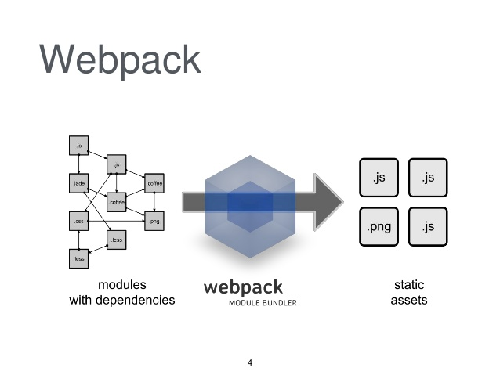
Modern Java script

Slide 37



Modern Java script

Slide 38


Modern Java script

Slide 39
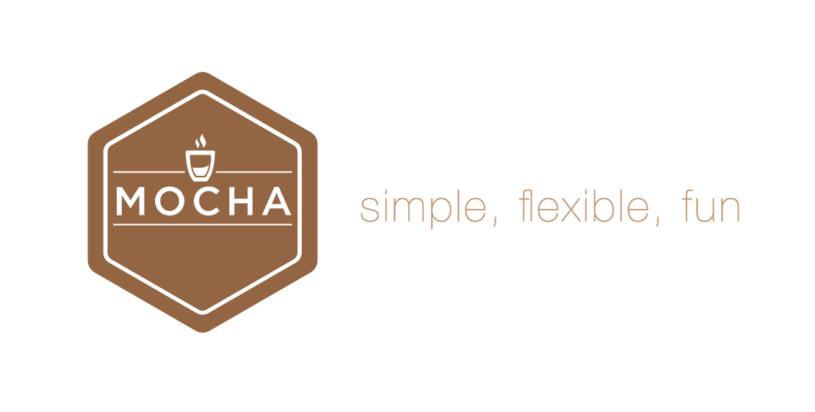
Modern Java script

Slide 40
Configuring a basic environment
npm install -g babel-cli
npm install --save-dev babel-cli babel-preset-es2015 babel-preset-stage-0
babel example.js --out-file compiled.js

