Slide 1
Patent Retrieval
Farhad Rezagholi – Amir Hadi
University of Kurdistan

Slide 2
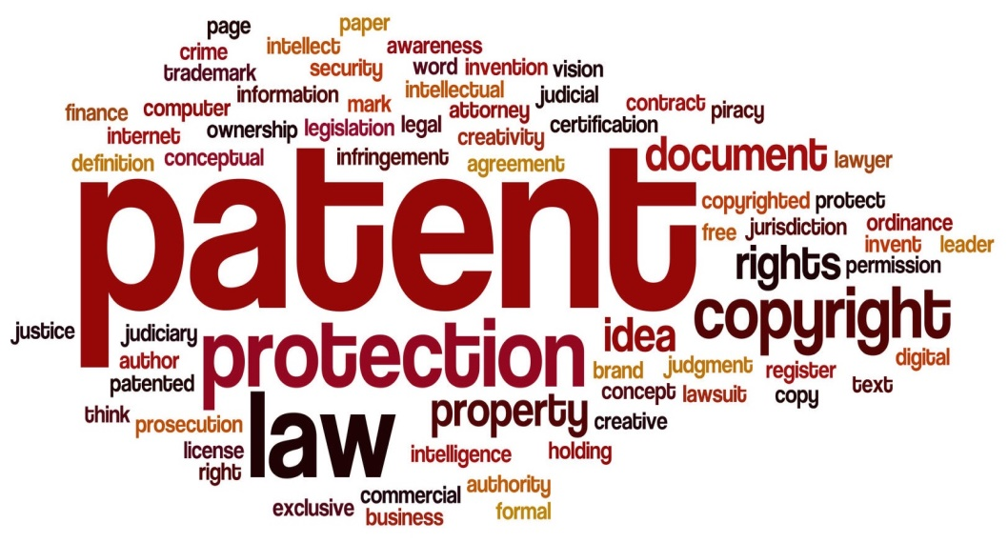
Table of Contents:
Introduction
Requirements for a patent
Types of patents
Ways to search patents
Sample of a patent doc
Sections of a patent doc
Query reformulation
PR methods

Slide 3
Introduction
A Patent is …
A property right granted by the Government to an inventor.
to exclude others from making, using, offering for sale, or selling the invention throughout the country or importing the invention into that country.
For a limited time.
in exchange for public disclosure of the invention when the patent is granted.

Slide 4
Requirements for a patent
New
Useful
Fully
disclosed
Unobvious

Slide 5
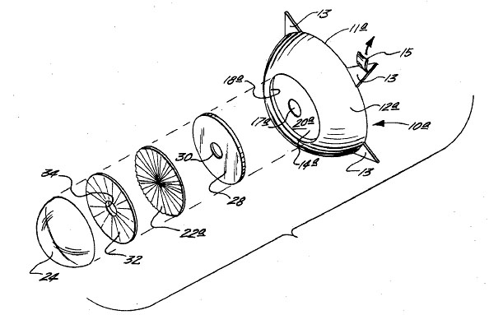
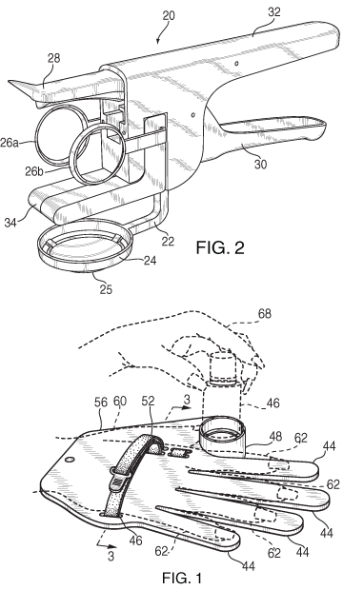
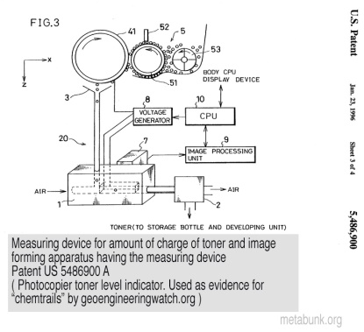
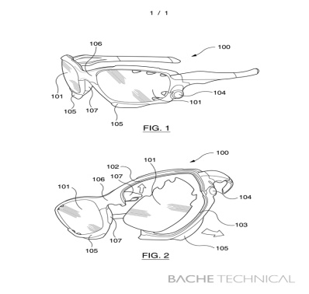
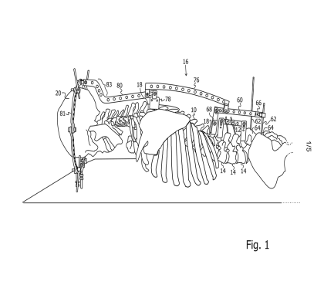
3 Types of Patents
Utility Patents granted :for a useful process or method, machine, manufactured article or composition of matter.
Term: 20 years from filing date

Slide 6
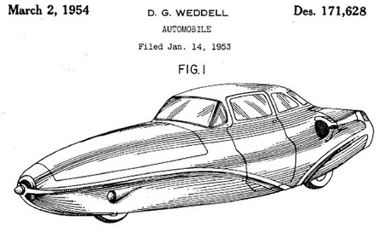
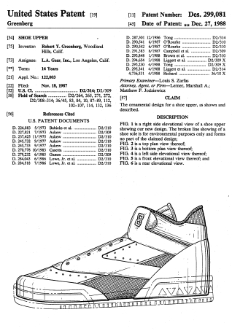
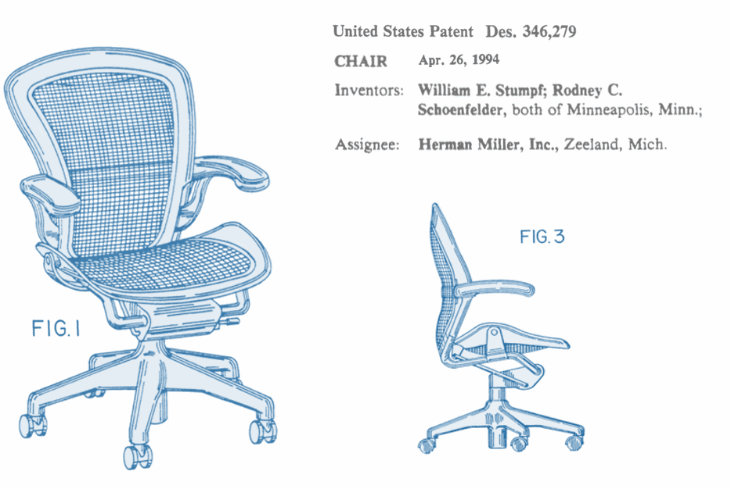
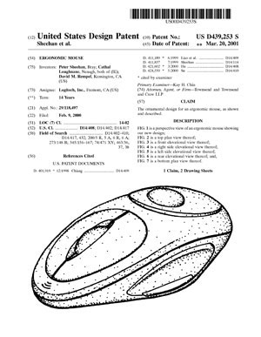
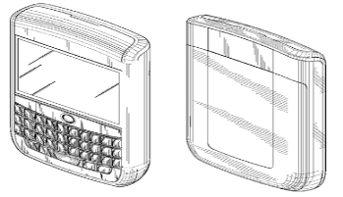
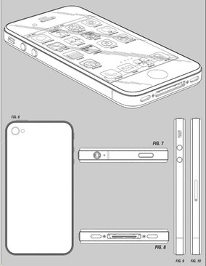
3 Types of Patents
Design Patents : granted for new, original and ornamental design for an article of manufacture: the appearance is protected.
Term: 14 years from the date the patent is granted

Slide 7
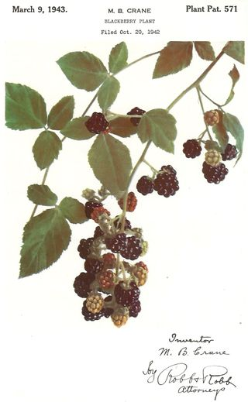
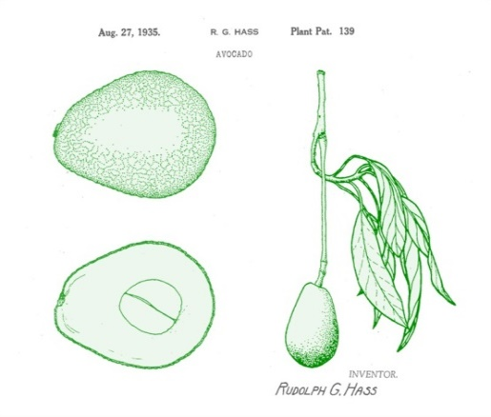
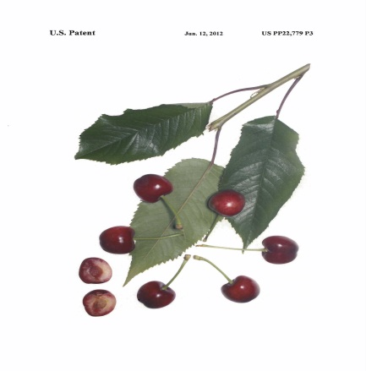
3 Types of Patents
Plant Patent : Granted to anyone who invents or discovers & asexually reproduces any distinct & new variety of plants.
Term: 20 years from filing date

Slide 8
Ways To Search for Pattents
USPTO
Indian Patent office (http://ipindia.nic.in)
European Patent Office (http://www.epo.org)
WIPO (http://www.wipo.int)
Japan Patent Office (http://www.jpo.go.jp)

Slide 9
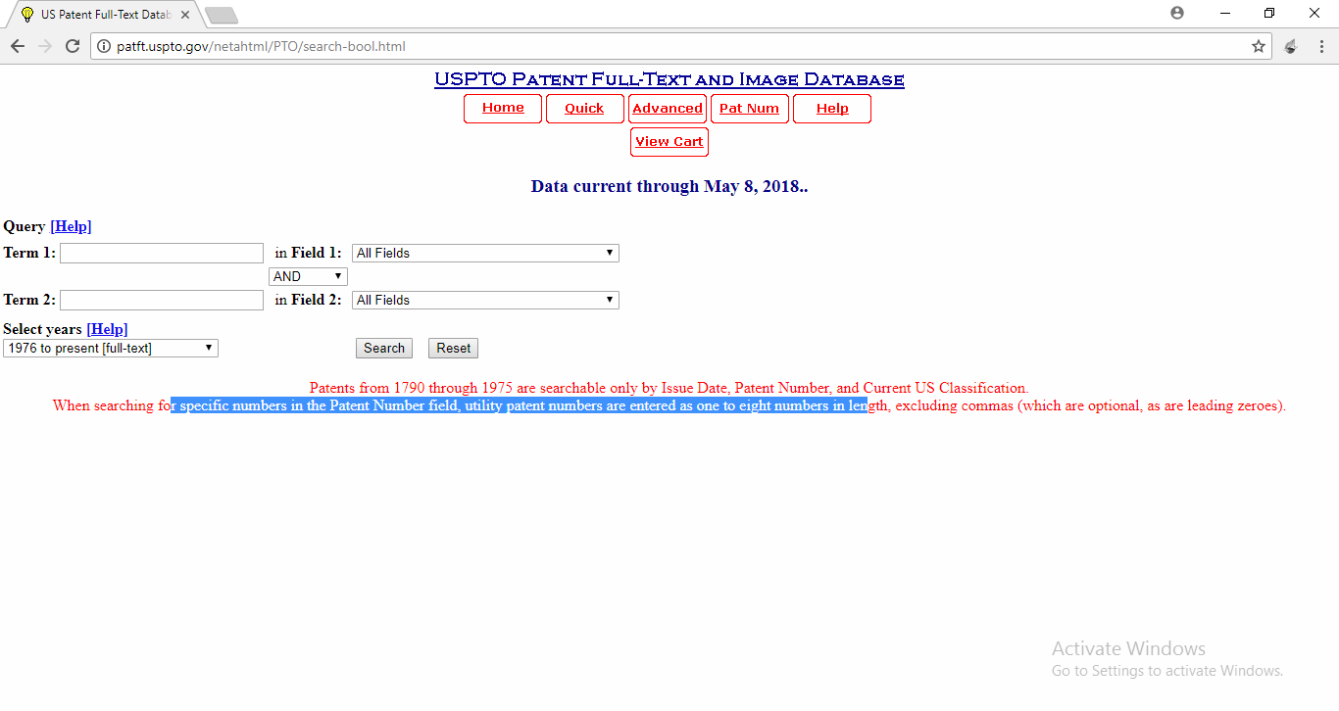
Ways To Search for Pattents
USPTO

Slide 10
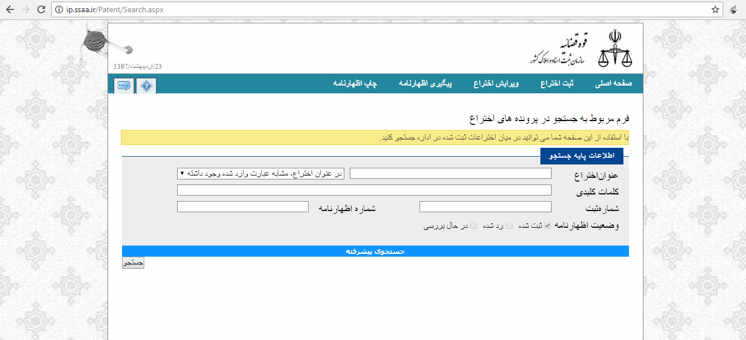
Ways To Search for Pattents
http://ip.ssaa.ir/Patent/Search.aspx

Slide 11
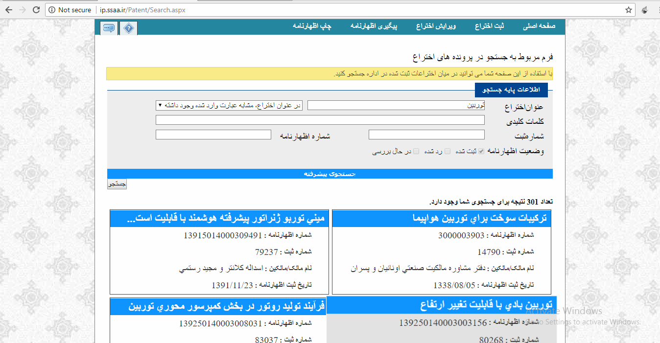
Ways To Search for Pattents

Slide 12
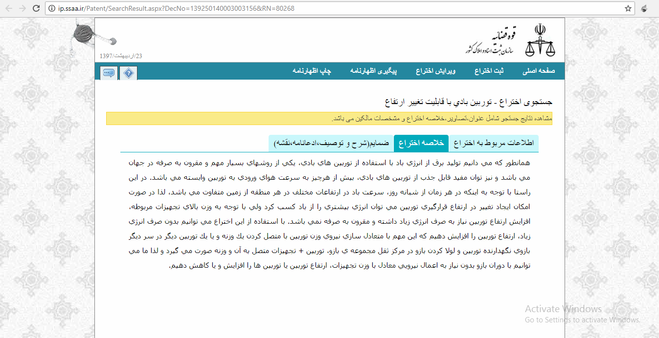
Ways To Search for Pattents

Slide 13
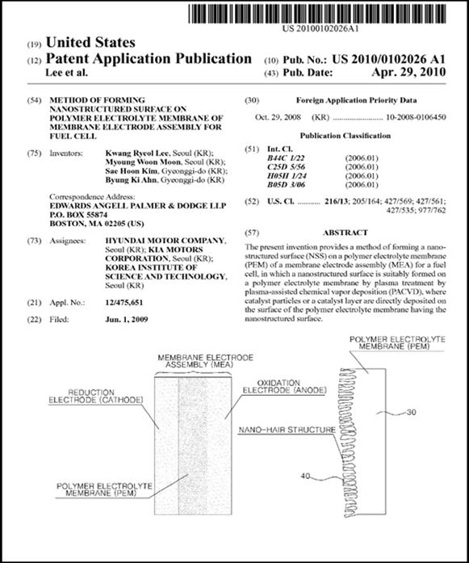
Sample of a patent document

Slide 14
Sections of a patent document
Title
Abstract
Description
articulate in details the technical specification of the invention and its possible embodiments
Claims
scope of protection sought by the inventor

Slide 15
Query Reformulation
Definition of Query Reformulation
transforming the input query Q into Q¯
reduction or expansion of Q terms
improve the retrievability of relevant documents

Slide 16
Query Reformulation
Query Reformulation (QRE) Performed:
Query Reduction(QR)
Query Expansion(QE)
Hybrid (QE & QR)

Slide 17
PR Methods
Keyword-based Methods
Pseudo Relevance Feedback (PRF)
Semantic-based Methods
Metadata-based Methods

Slide 18
Thanks !!!

