Slide 1
Clustering

Slide 2
Proposed Changes
Microarrays – very poor intro – can we find better slides in BIO section?

Slide 3
Outline
Microarrays
Hierarchical Clustering
K-Means Clustering
Corrupted Cliques Problem
CAST Clustering Algorithm

Slide 4
Applications of Clustering
Viewing and analyzing vast amounts of biological data as a whole set can be perplexing
It is easier to interpret the data if they are partitioned into clusters combining similar data points.

Slide 5
Inferring Gene Functionality
Researchers want to know the functions of newly sequenced genes
Simply comparing the new gene sequences to known DNA sequences often does not give away the function of gene
For 40% of sequenced genes, functionality cannot be ascertained by only comparing to sequences of other known genes
Microarrays allow biologists to infer gene function even when sequence similarity alone is insufficient to infer function.

Slide 6
Microarrays and Expression Analysis
Microarrays measure the activity (expression level) of the genes under varying conditions/time points
Expression level is estimated by measuring the amount of mRNA for that particular gene
A gene is active if it is being transcribed
More mRNA usually indicates more gene activity

Slide 7
Microarray Experiments
Produce cDNA from mRNA (DNA is more stable)
Attach phosphor to cDNA to see when a particular gene is expressed
Different color phosphors are available to compare many samples at once
Hybridize cDNA over the micro array
Scan the microarray with a phosphor-illuminating laser
Illumination reveals transcribed genes
Scan microarray multiple times for the different color phosphor’s

Slide 8
Microarray Experiments (con’t)
Phosphors can be added here instead
Then instead of staining, laser illumination can be used
www.affymetrix.com

Slide 9
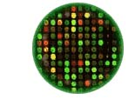
Using Microarrays
Green: expressed only from control
Red: expressed only from experimental cell
Yellow: equally expressed in both samples
Black: NOT expressed in either control or experimental cells

Slide 10
Microarray Data-show in the matrix which genes are similar and which are not.
Microarray data are usually transformed into an intensity matrix (below)
The intensity matrix allows biologists to make correlations between diferent genes (even if they are
dissimilar) and to understand how genes functions might be related
Clustering comes into play
Time: | Time X | Time Y | Time Z
Gene 1 | 10 | 8 | 10
Gene 2 | 10 | 0 | 9
Gene 3 | 4 | 8.6 | 3
Gene 4 | 7 | 8 | 3
Gene 5 | 1 | 2 | 3
Intensity (expression level) of gene at measured time

Slide 11
Clustering of Microarray Data
Plot each datum as a point in N-dimensional space
Make a distance matrix for the distance between every two gene points in the N-dimensional space
Genes with a small distance share the same expression characteristics and might be functionally related or similar.
Clustering reveal groups of functionally related genes

Slide 12
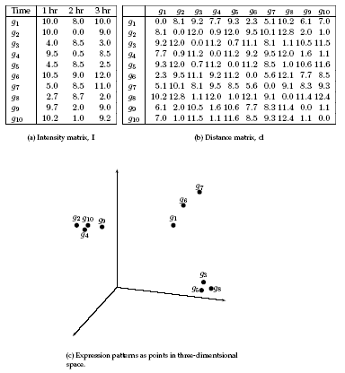
Clustering of Microarray Data (cont’d)
Clusters

Slide 13
Homogeneity and Separation Principles
Homogeneity: Elements within a cluster are close to each other
Separation: Elements in different clusters are further apart from each other
Given these points a clustering algorithm might make two distinct clusters as follows

Slide 14
Bad Clustering
This clustering violates both Homogeneity and Separation principles
Close distances from points in separate clusters
Far distances from points in the same cluster

Slide 15
Good Clustering
This clustering satisfies both Homogeneity and Separation principles

Slide 16
Clustering Techniques
Agglomerative: Start with every element in its own cluster, and iteratively join clusters together
Divisive: Start with one cluster and iteratively divide it into smaller clusters
Hierarchical: Organize elements into a tree, leaves represent genes and the length of the pathes between leaves represents the distances between genes. Similar genes lie within the same subtrees

Slide 17
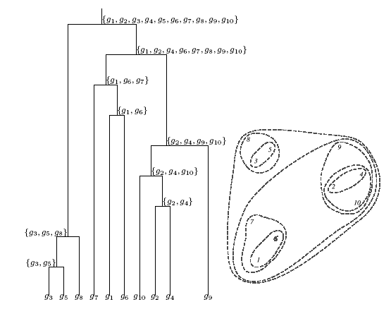
Hierarchical Clustering

Slide 18
Hierarchical Clustering Algorithm
Hierarchical Clustering (d , n)
Form n clusters each with one element
Construct a graph T by assigning one vertex to each cluster
while there is more than one cluster
Find the two closest clusters C₁ and C₂
Merge C₁ and C₂ into new cluster C with |C₁| +|C₂| elements
Compute distance from C to all other clusters
Add a new vertex C to T and connect to vertices C₁ and C₂
Remove rows and columns of d corresponding to C₁ and C₂
Add a row and column to d corrsponding to the new cluster C
return T
The algorithm takes a nxn distance matrix d of pairwise distances between points as an input.

Slide 19
Hierarchical Clustering Algorithm
Hierarchical Clustering (d , n)
Form n clusters each with one element
Construct a graph T by assigning one vertex to each cluster
while there is more than one cluster
Find the two closest clusters C₁ and C₂
Merge C₁ and C₂ into new cluster C with |C₁| +|C₂| elements
Compute distance from C to all other clusters
Add a new vertex C to T and connect to vertices C₁ and C₂
Remove rows and columns of d corresponding to C₁ and C₂
Add a row and column to d corrsponding to the new cluster C
return T
Different ways to define distances between clusters may lead to different clusterings

Slide 20
Hierarchical Clustering: Recomputing Distances
d_{min}(C, C*) = min d(x,y)
for all elements x in C and y in C*
Distance between two clusters is the smallest distance between any pair of their elements
d_{avg}(C, C*) = (1 / |C*||C|) ∑ d(x,y)
for all elements x in C and y in C*
Distance between two clusters is the average distance between all pairs of their elements

Slide 21
Squared Error Distortion
Given a data point v and a set of points X,
define the distance from v to X
d(v, X)
as the (Eucledian) distance from v to the closest point from X.
Given a set of n data points V={v₁…v_{n}} and a set of k points X,
define the Squared Error Distortion
d(V,X) = ∑d(v_{i}, X)² / n 1 < i < n

Slide 22
K-Means Clustering Problem: Formulation
Input: A set, V, consisting of n points and a parameter k
Output: A set X consisting of k points (cluster centers) that minimizes the squared error distortion d(V,X) over all possible choices of X

Slide 23
1-Means Clustering Problem: an Easy Case
Input: A set, V, consisting of n points
Output: A single points x (cluster center) that minimizes the squared error distortion d(V,x) over all possible choices of x

Slide 24
1-Means Clustering Problem: an Easy Case
Input: A set, V, consisting of n points
Output: A single points x (cluster center) that minimizes the squared error distortion d(V,x) over all possible choices of x
1-Means Clustering problem is easy.
However, it becomes very difficult (NP-complete) for more than one center.
An efficient heuristic method for K-Means clustering is the Lloyd algorithm

Slide 25
K-Means Clustering: Lloyd Algorithm
Lloyd Algorithm
Arbitrarily assign the k cluster centers
while the cluster centers keep changing
Assign each data point to the cluster C_{i} corresponding to the closest cluster representative (center) (1 ≤ i ≤ k)
After the assignment of all data points, compute new cluster representatives according to the center of gravity of each cluster, that is, the new cluster representative is
∑v \ |C| for all v in C for every cluster C
*This may lead to merely a locally optimal clustering.

Slide 26
x₁
x₂
x₃

Slide 27
x₁
x₂
x₃

Slide 28
x₁
x₃
x₂

Slide 29
x₁
x₂
x₃

Slide 30
Conservative K-Means Algorithm
Lloyd algorithm is fast but in each iteration it moves many data points, not necessarily causing better convergence.
A more conservative method would be to move one point at a time only if it improves the overall clustering cost (Squared Error Distortion is one particular choice of cost)
The smaller the clustering cost of a partition of data points is the better that clustering is
Different methods (e.g., the squared error distortion) can be used to measure this clustering cost

Slide 31
K-Means “Greedy” Algorithm
ProgressiveGreedyK-Means(k)
Select an arbitrary partition P into k clusters
while forever
bestChange ← 0
for every cluster C
for every element i not in C
if moving i to cluster C reduces its clustering cost
if (cost(P) – cost(P_{i → C}) > bestChange
bestChange ← cost(P) – cost(P_{i → C})
i* ← I
C* ← C
if bestChange > 0
Change partition P by moving i* to C*
else
return P

Slide 32
Clique Graphs
A clique is a graph with every vertex connected to every other vertex
A clique graph is a graph where each connected component is a clique

Slide 33
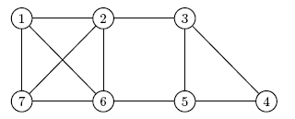
Transforming an Arbitrary Graph into a Clique Graphs
A graph can be transformed into a
clique graph by adding or removing edges

Slide 34
Clique Graphs (cont’d) – REVISION –show yet another way of transformation and compare the costs.
A graph can be transformed into a clique graph by adding or removing edges
Example: removing two edges to make a clique graph

Slide 35
Corrupted Cliques Problem
Input: A graph G
Output: The smallest number of additions and removals of edges that will transform G into a clique graph

Slide 36
Distance Graphs
Turn the distance matrix into a distance graph
Genes are represented as vertices in the graph
Choose a distance threshold θ
If the distance between two vertices is below θ, draw an edge between them
The resulting graph may contain cliques
These cliques represent clusters of closely located data points!

Slide 37
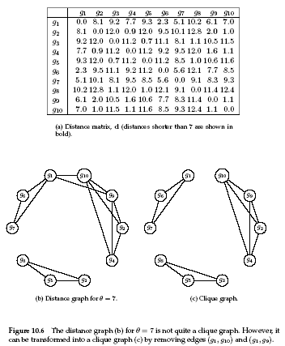
Transforming Distance Graph into Clique Graph
The distance graph (threshold θ=7) is transformed into a clique graph after removing the two highlighted edges
After transforming the distance graph into the clique graph, the dataset is partitioned into three clusters

Slide 38
Heuristics for Corrupted Clique Problem
Corrupted Cliques problem is NP-Hard, some heuristics exist to approximately solve it:
CAST (Cluster Affinity Search Technique): a practical and fast algorithm:
CAST is based on the notion of genes close to cluster C or distant from cluster C
Distance between gene i and cluster C:
d(i,C) = average distance between gene i and all genes in C
Gene i is close to cluster C if d(i,C)< θ and distant otherwise

Slide 39
CAST Algorithm
CAST(S, G, θ)
P ← Ø
while S ≠ Ø
V ← vertex of maximal degree in the distance graph G
C ← {v}
while a close gene i not in C or distant gene i in C exists
Find the nearest close gene i not in C and add it to C
Remove the farthest distant gene i in C
Add cluster C to partition P
S ← S \ C
Remove vertices of cluster C from the distance graph G
return P
S – set of elements, G – distance graph, θ - distance threshold

