Slide 1
Sequence Alignment
By:
Sadegh Sulaimany
University of Kurdistan

Slide 2
Outline
Dynamic Programming vs. Recursion
DNA Sequence Comparison: Easy way
DNA Sequence Comparison: First Success Stories
Relation of Sequences
Comparing Sequences
Hamming Distance vs. Edit Distance
Sequence Alignment
Longest Common Subsequence Problem
Scoring Matrices: PAM and BLOSUM
Local vs. Global Alignment

Slide 3
Problem Solving Approach
Divide and Conquer
  Top-Down Approach
  Repetitive calculations
  LIFO Approach
  Mem: Return Point+Environmental Variables and Runtime Stack
Dynamic Programming
  Bottom-Up Approach
  Calculate each once
  FIFO Approach
  Result Table
Fibonacci Example

Slide 4
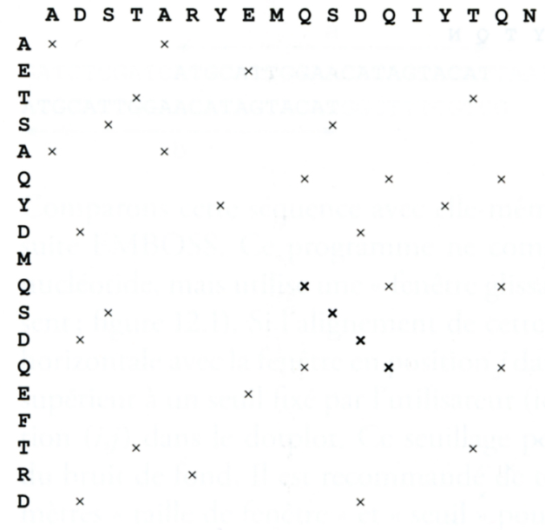
Sequence Comparison: Easiest way
Dot plot

Slide 5
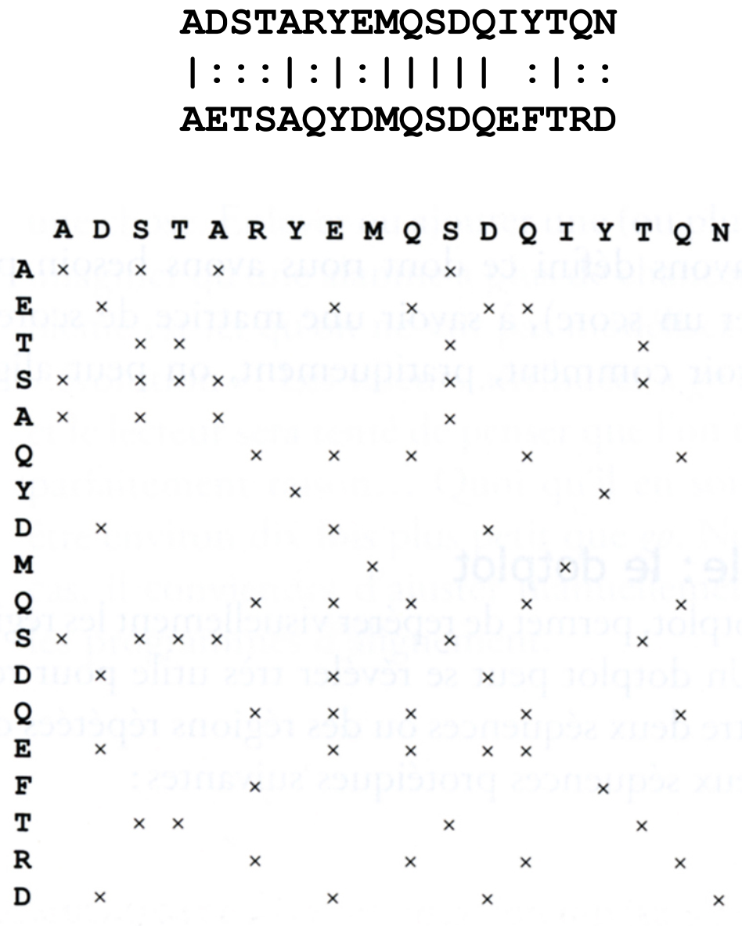
Sequence Comparison: Easiest way
Dot plot

Slide 6
DNA Sequence Comparison: First Success Story
Finding sequence similarities with genes of known function is a common approach to infer a newly sequenced gene’s function
Computing a similarity score between two genes tells how likely it is that they have similar functions
Dynamic programming is a technique for revealing similarities between genes

Slide 7
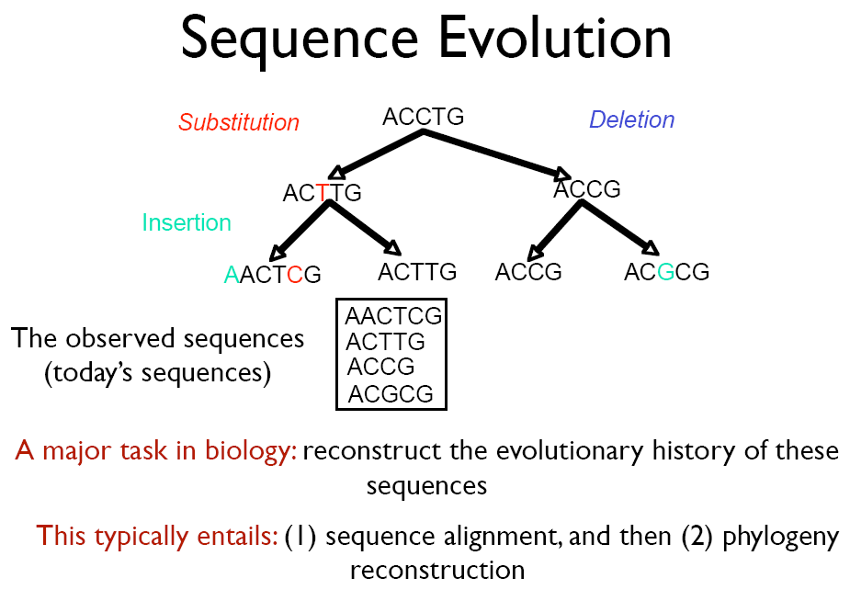

Slide 8
Relation Of Sequences
Homolog
  Has a Common ancestor
    Ortholog
    Gene or Protein Family Members In 2 different organism
    Paralog
    Gene or Protein Family Members In 1 organism
Xenolog
  Have Some Similarities but not from a common ancestor

Slide 9
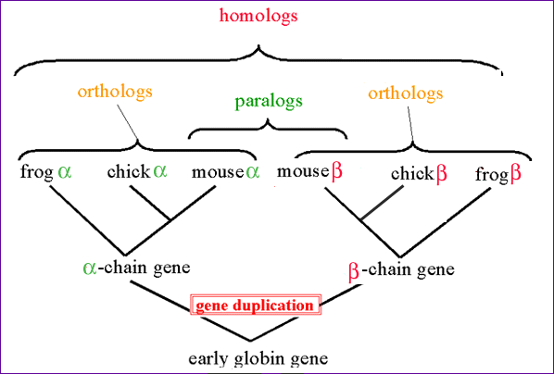
Relation Of Sequences

Slide 10
Comparing Sequences
Sequence Alignment
  Pairwise Sequence Alignment
    Between 2 Sequences
  Multiple Sequence Alignment
    Between more than 2 Sequences

Slide 11
Aligning Sequences without Insertions and Deletions: Hamming Distance
Given two DNA sequences v and w :
v :
A
T
A
T
A
T
A
T
w :
T
A
T
A
T
A
T
A
The Hamming distance: d_{H}(v, w) = 8 is large but the sequences are very similar

Slide 12
Aligning Sequences with Insertions and Deletions
By shifting one sequence over one position:
v :
A
T
A
T
A
T
A
T
--
w :
--
T
A
T
A
T
A
T
A
The edit distance: d_{H}(v, w) = 2.
Hamming distance neglects insertions and deletions in DNA

Slide 13
Edit Distance
Levenshtein (1966) introduced edit distance between two strings as the minimum number of elementary operations (insertions, deletions, and substitutions) to transform one string into the other
d(v,w) = MIN number of elementary operations
to transform v → w

Slide 14
Edit Distance vs Hamming Distance
Hamming distance
always compares
i^{-th} letter of v with
i^{-th} letter of w
Edit distance
may compare
i^{-th} letter of v with
j^{-th} letter of w
V = ATATATAT
Just one shift
V = - ATATATAT
W = TATATATA
Make it all line up
W = TATATATA
Hamming distance: Edit distance:
d(v, w)=8 d(v, w)=2
(one insertion and one deletion)
How to find what j goes with what i ???

Slide 15
Edit Distance: Example
TGCATAT → ATCCGAT in 4 steps
Can it be done in 3 steps???

Slide 16
Aligning DNA Sequences
V = ATCTGATG
n = 8
4
matches
mismatches
insertions
deletions
W = TGCATAC
m = 7
1
2
match
2
mismatch
V
A | T |  | C |  | T | G | A | T | G
 | T | G | C | A | T |  | A |  | C
W
indels
deletion
insertion

Slide 17
Longest Common Subsequence (LCS) – Alignment without Mismatches
Given two sequences
v = v₁ v₂…v_{m} and w = w₁ w₂…w_{n}
The LCS of v and w is a sequence of positions in
v: 1 < i₁ < i₂ < … < i_{t} < m
and a sequence of positions in
w: 1 < j₁ < j₂ < … < j_{t} < n
such that i_{t} -th letter of v equals to j_{t}-letter of w and t is maximal

Slide 18
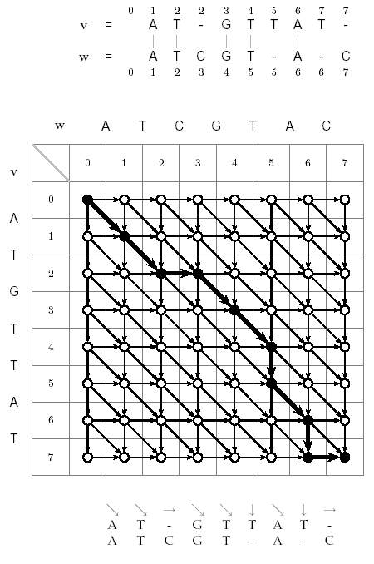
LCS: Dynamic Programming
Find the LCS of two strings
Input: A weighted graph G with two distinct vertices, one labeled “source” one labeled “sink”
Output: A longest path in G from “source” to “sink”
Solve using an LCS edit graph with diagonals replaced with +1 edges

Slide 19
Edit Graph for LCS Problem
j
A
T
C
T
G
A
T
C
0
1
2
3
4
5
6
7
8
Every path is a common subsequence.
Every diagonal edge adds an extra element to common subsequence
LCS Problem: Find a path with maximum number of diagonal edges
i
0
T
1
G
2
C
3
A
4
T
5
A
6
C
7

Slide 20
Computing LCS
Let v_{i} = prefix of v of length i: v₁ … v_{i}
and w_{j} = prefix of w of length j: w₁ … w_{j}
The length of LCS(v_{i},w_{j}) is computed by:
s_{i-1, j}
s_{i, j-1}
s_{i-1, j-1} + 1 if v_{i} = w_{j}
s_{i, j} =
max

Slide 21
Computing LCS (cont’d)
i-1,j -1
i-1,j
s_{i-1,j} + 0
1
0
s_{i,j} = MAX
s_{i,j -1} + 0
i,j -1
0
i,j
s_{i-1,j -1} + 1, if v_{i} = w_{j}
  Every alignment path is from source to sink

Slide 22
Every Path in the Grid Corresponds to an Alignment
W
A
T
C
G
0 1 2 2 3 4
V = A T - G T
| | |
W= A T C G –
0 1 2 3 4 4
V
 | 0 | 1 | 2 | 3 | 4
0
1
2
3
4
A
T
G
T

Slide 23
Alignment as a Path in the Edit Graph
w
A
T
C
G
T
A
C
v
0
1
2
3
4
5
6
7
0 1 2 2 3 4 5 6 7 7
A T _ G T T A T _
A T C G T _ A _ C
0 1 2 3 4 5 5 6 6 7
(0,0) , (1,1) , (2,2), (2,3), (3,4), (4,5), (5,5), (6,6), (7,6), (7,7)
0
A
1
T
2
G
3
- Corresponding path -
T
4
T
5
A
6
T
7

Slide 24
Alignment: Dynamic Programming
s_{i,j} = s_{i-1, j-1}+1 if v_{i} = w_{j}
_{max} s_{i-1, j}
s_{i, j-1}
{
Arrows show where the score originated from.
if from the top
if from the left
if v_{i} = w_{j}

Slide 25
Backtracking Example
A
T
C
G
T
A
C
Find a match in row and column 2.
i=2, j=2,5 is a match (T).
j=2, i=4,5,7 is a match (T).
Since v_{i} = w_{j,} s_{i,j} = s_{i-1,j-1} +1
s_{2,2} = [s_{1,1} = 1] + 1
s_{2,5} = [s_{1,4} = 1] + 1
s_{4,2} = [s_{3,1} = 1] + 1
s_{5,2} = [s_{4,1} = 1] + 1
s_{7,2} = [s_{6,1} = 1] + 1
w
v
0
1
2
3
4
5
6
7
0
0
0
0
0
0
0
0
0
A
1
0
1
1
1
1
1
1
1
T
2
0
1
2
2
2
2
2
2
G
3
0
1
2
T
4
0
1
2
T
5
0
1
2
A
6
0
1
2
T
7
0
1
2

Slide 26
LCS Algorithm
LCS(v,w)
for i ← 1 to n
s_{i,0} ← 0
for j ← 1 to m
s_{0,j} ← 0
for i ← 1 to n
for j ← 1 to m
s_{i-1,j}
s_{i,j} ← max s_{i,j-1}
s_{i-1,j-1} + 1, if v_{i} = w_{j}
“ “ if s_{i,j} = s_{i-1,j}
b_{i,j} ← “ “ if s_{i,j} = s_{i,j-1}
“ “ if s_{i,j} = s_{i-1,j-1} + 1
return (s_{n,m}, b)
{
{

Slide 27
Printing LCS: Backtracking
PrintLCS(b,v,i,j)
if i = 0 or j = 0
return
if b_{i,j} = “ “
PrintLCS(b,v,i-1,j-1)
print v_{i}
else
if b_{i,j} = “ “
PrintLCS(b,v,i-1,j)
else
PrintLCS(b,v,i,j-1)

Slide 28
LCS Runtime
It takes O(nm) time to fill in the nxm dynamic programming matrix.
Why O(nm)? The pseudocode consists of a nested “for” loop inside of another “for” loop to set up a nxm matrix.

Slide 29
From LCS to Alignment: Change up the Scoring
The Longest Common Subsequence (LCS) problem—the simplest form of sequence alignment – allows only insertions and deletions (no mismatches).
In the LCS Problem, we scored 1 for matches and 0 for indels
Consider penalizing indels and mismatches with negative scores
Simplest scoring schema:
+1 : match premium
-μ : mismatch penalty
-σ : indel penalty

Slide 30
Simple Scoring
When mismatches are penalized by –μ, indels are penalized by –σ,
and matches are rewarded with +1,
the resulting score is:
#matches – μ(#mismatches) – σ (#indels)

Slide 31
The Global Alignment Problem
Find the best alignment between two strings under a given scoring schema
Input : Strings v and w and a scoring schema
Output : Alignment of maximum score
↑→ = -б
= 1 if match
= -µ if mismatch
s_{i-1,j-1} +1 if v_{i} = w_{j}
s_{i,j} = max s _{i-1,j-1} -µ if v_{i} ≠ w_{j}
s _{i-1,j} - σ
s _{i,j-1} - σ
{
μ : mismatch penalty
σ : indel penalty

Slide 32
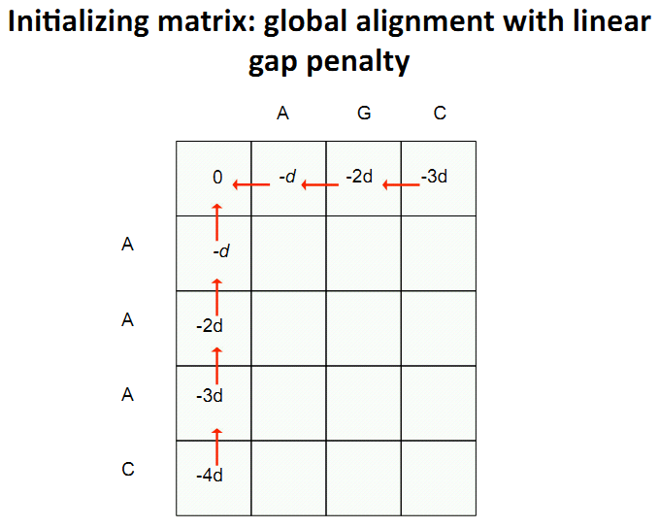

Slide 33
Scoring Matrices
To generalize scoring, consider a (4+1) x(4+1) scoring matrix δ.
In the case of an amino acid sequence alignment, the scoring matrix would be a (20+1)x(20+1) size. The addition of 1 is to include the score for comparison of a gap character “-”.
This will simplify the algorithm as follows:
s_{i-1,j-1} + δ (v_{i}, w_{j})
s_{i,j} = max s _{i-1,j} + δ (v_{i}, -)
s _{i,j-1} + δ (-, w_{j})
{

Slide 34
Making a Scoring Matrix
Scoring matrices are created based on biological evidence.
Alignments can be thought of as two sequences that differ due to mutations.
Some of these mutations have little effect on the protein’s function, therefore some penalties, δ(v_{i} , w_{j}), will be less harsh than others.

Slide 35
Scoring Matrix: Example
 | A | R | N | K
A | 5 | -2 | -1 | -1
R | - | 7 | -1 | 3
N | - | - | 7 | 0
K | - | - | - | 6
Notice that although R and K are different amino acids, they have a positive score.
Why? They are both positively charged amino acids→ will not greatly change function of protein.
AKRANR
KAAANK
-1 + (-1) + (-2) + 5 + 7 + 3 = 11

Slide 36
Conservation
Amino acid changes that tend to preserve the physico-chemical properties of the original residue
  Polar to polar
    aspartate → glutamate
  Nonpolar to nonpolar
    alanine → valine
  Similarly behaving residues
    leucine to isoleucine

Slide 37
Scoring matrices
Amino acid substitution matrices
  PAM
  BLOSUM
DNA substitution matrices
  DNA is less conserved than protein sequences
  Less effective to compare coding regions at nucleotide level

Slide 38
PAM
Point Accepted Mutation (Dayhoff et al.)
1 PAM = PAM₁ = 1% average change of all amino acid positions
  After 100 PAMs of evolution, not every residue will have changed
    some residues may have mutated several times
    some residues may have returned to their original state
    some residues may not changed at all

Slide 39
PAM_{X}
PAM_{x} = PAM₁^{x}
  PAM₂₅₀ = PAM₁²⁵⁰
PAM₂₅₀ is a widely used scoring matrix:
Ala Arg Asn Asp Cys Gln Glu Gly His Ile Leu Lys ...
A R N D C Q E G H I L K ...
Ala A 13 6 9 9 5 8 9 12 6 8 6 7 ...
Arg R 3 17 4 3 2 5 3 2 6 3 2 9
Asn N 4 4 6 7 2 5 6 4 6 3 2 5
Asp D 5 4 8 11 1 7 10 5 6 3 2 5
Cys C 2 1 1 1 52 1 1 2 2 2 1 1
Gln Q 3 5 5 6 1 10 7 3 7 2 3 5
...
Trp W 0 2 0 0 0 0 0 0 1 0 1 0
Tyr Y 1 1 2 1 3 1 1 1 3 2 2 1
Val V 7 4 4 4 4 4 4 4 5 4 15 10

Slide 40
BLOSUM
Blocks Substitution Matrix
Scores derived from observations of the frequencies of substitutions in blocks of local alignments in related proteins
Matrix name indicates evolutionary distance
  BLOSUM62 was created using sequences sharing no more than 62% identity

Slide 41
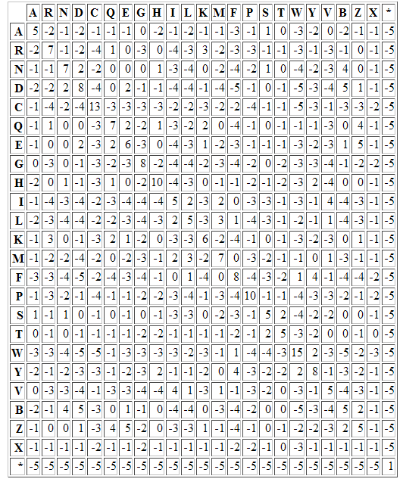
The Blosum50 Scoring Matrix

Slide 42
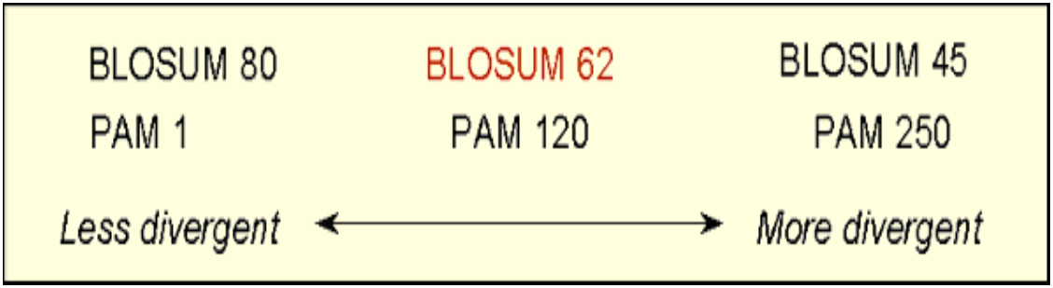
Comparing PAM and BLOSUM

Slide 43
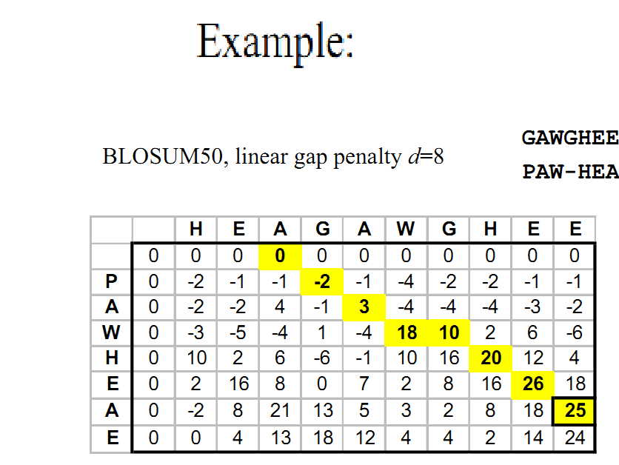

Slide 44
Local vs. Global Alignment
The Global Alignment Problem tries to find the longest path between vertices (0,0) and (n,m) in the edit graph.
The Local Alignment Problem tries to find the longest path among paths between arbitrary vertices (i,j) and (i’, j’) in the edit graph.

Slide 45
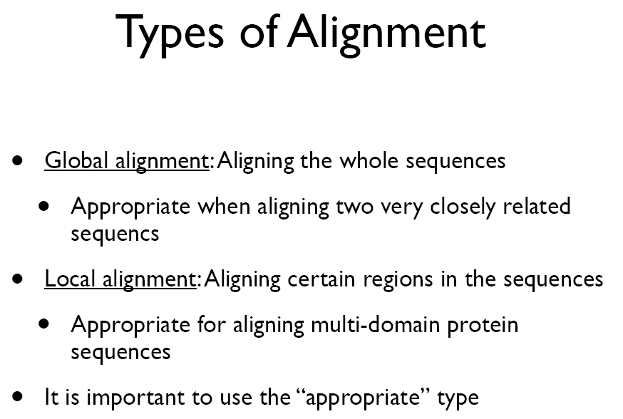

Slide 46
Local vs. Global Alignment
The Global Alignment Problem tries to find the longest path between vertices (0,0) and (n,m) in the edit graph.
The Local Alignment Problem tries to find the longest path among paths between arbitrary vertices (i,j) and (i’, j’) in the edit graph.
In the edit graph with negatively-scored edges, Local Alignmet may score higher than Global Alignment

Slide 47
Local vs. Global Alignment (cont’d)
Global Alignment
Local Alignment—better alignment to find conserved segment
--T—-CC-C-AGT—-TATGT-CAGGGGACACG—A-GCATGCAGA-GAC
| || | || | | | ||| || | | | | |||| |
AATTGCCGCC-GTCGT-T-TTCAG----CA-GTTATG—T-CAGAT--C
tccCAGTTATGTCAGgggacacgagcatgcagagac
||||||||||||
aattgccgccgtcgttttcagCAGTTATGTCAGatc

Slide 48
Local Alignment: Example
Compute a “mini” Global Alignment to get Local
Local alignment
Global alignment

Slide 49
Similarity Based on Dot Plots
Simple Dot Plot
Dot Plot With 75% identity Filtering

Slide 50
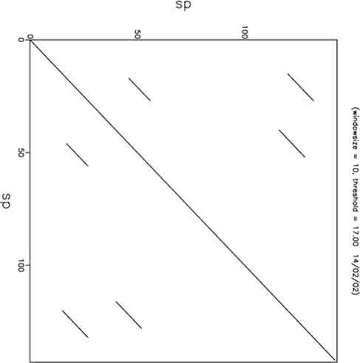
Dotplot for a small protein against itself
identity (i=j)
similarity of sequence
with other parts of itself
50

Slide 51
Local Alignments: Why?
Two genes in different species may be similar over short conserved regions and dissimilar over remaining regions.
Example:
  Homeobox genes have a short region called the homeodomain that is highly conserved between species.
  A global alignment would not find the homeodomain because it would try to align the ENTIRE sequence

Slide 52
The Local Alignment Problem
Goal: Find the best local alignment between two strings
Input : Strings v, w and scoring matrix δ
Output : Alignment of substrings of v and w whose alignment score is maximum among all possible alignment of all possible substrings

Slide 53
The Problem with this Problem
Long run time O(n⁴):
- In the grid of size n x n there are ~n² vertices (i,j) that may serve as a source.
- For each such vertex computing alignments from (i,j) takes O(n²) time.

Slide 54
The Local Alignment Recurrence
The largest value of s_{i,j} over the whole edit graph is the score of the best local alignment.
The recurrence:
Power of ZERO: there is only this change from the original recurrence of a Global Alignment - since there is only one “free ride” edge entering into every vertex
0
s_{i,j} = max s_{i-1,j-1} + δ (v_{i}, w_{j})
s _{i-1,j} + δ (v_{i}, -)
s _{i,j-1} + δ (-, w_{j})
{

Slide 55
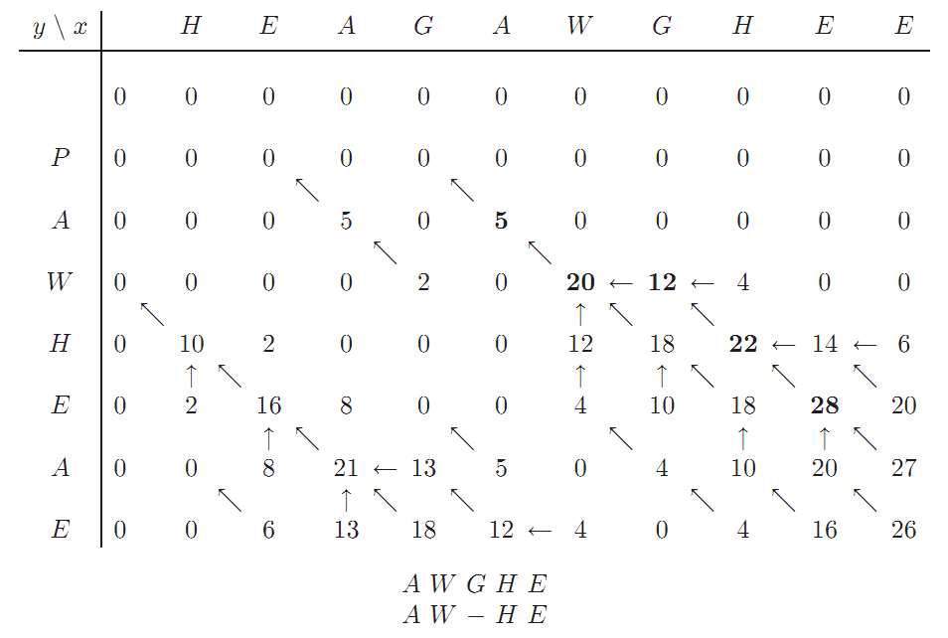
Local Align vs. Global Align

Slide 56
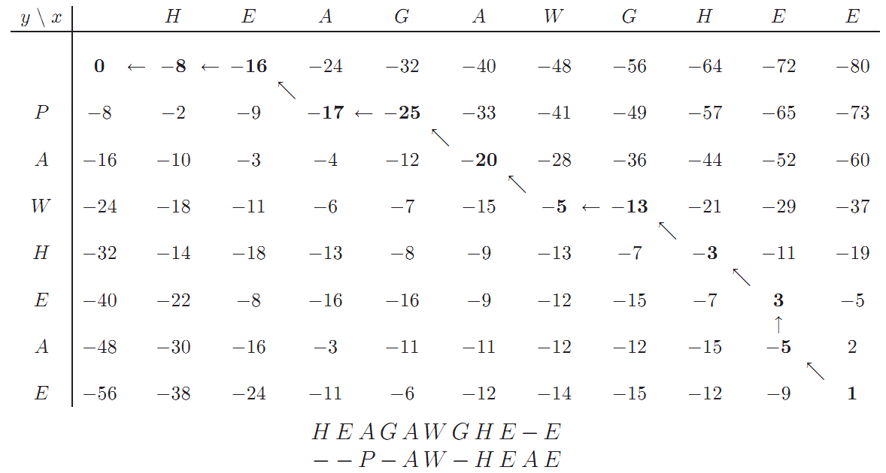
Local Align vs. Global Align

Slide 57
Further Reading
Better Gap penalty strategy
  -(ρ + σx)
Multiple Sequence Alignment
x: AC-GCGG-C
y: AC-GC-GAG
z: GCCGC-GAG

Slide 58
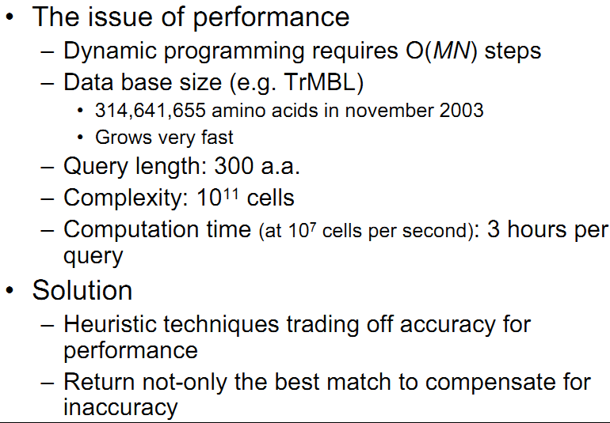
Heuristic Alignment Algorithms

Slide 59
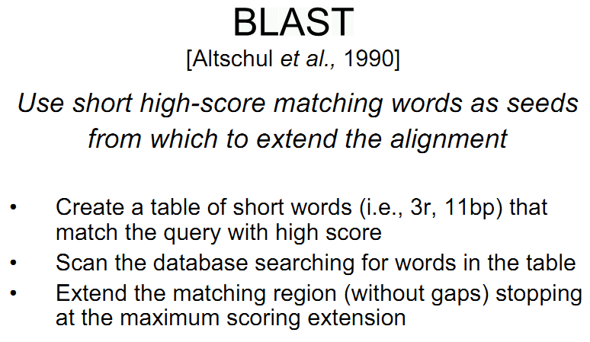

Slide 60
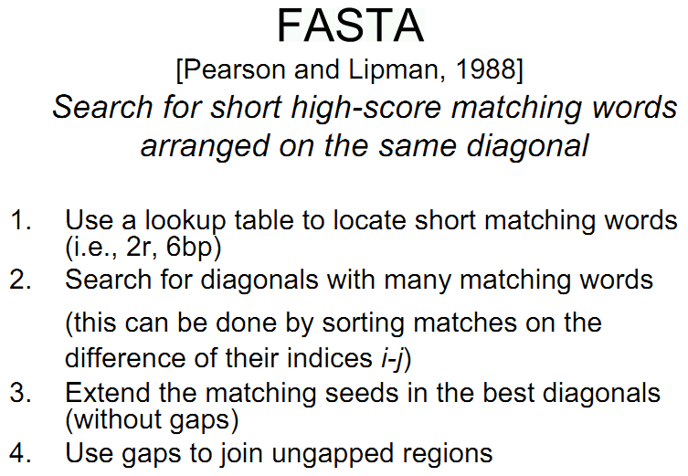

Slide 61
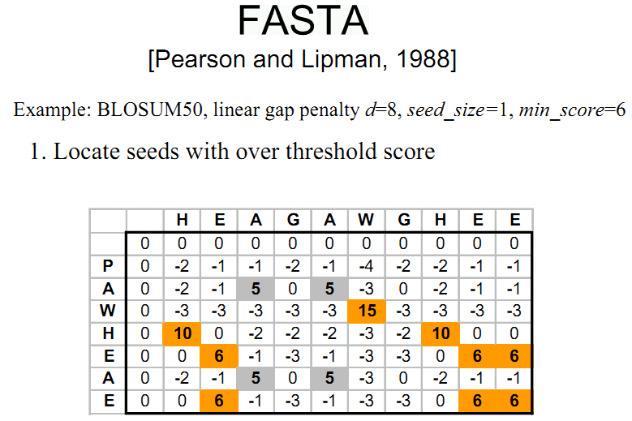

Slide 62
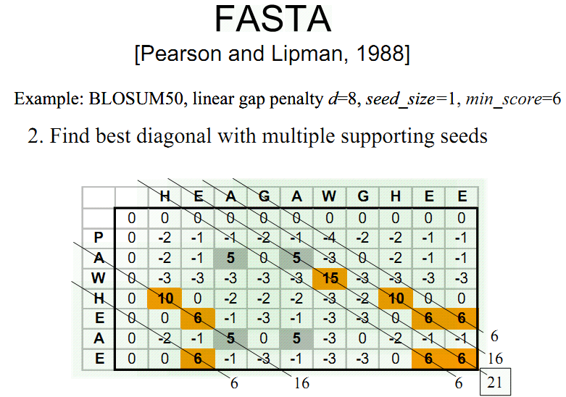

Slide 63
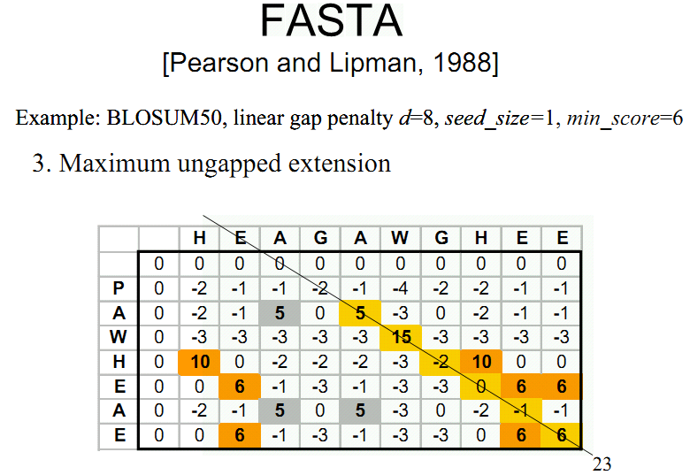

Slide 64
