Slide 1
Design Patterns
Rashed Fatehi

Slide 2
Introduction

Slide 3
Introduction
OOP?
Resolve complexity?
Why design patterns?

Slide 4
What is design pattern?

Slide 5
What is design pattern?
Design patterns are typical solutions to common problems in software design.

Slide 6
The Catalog of Design Patterns
Creational patterns: Provide various object creation mechanisms
Structural patterns: Explain how to assemble objects and classes into larger structures, while keeping these structures flexible and efficient
Behavioral patterns: Concerned with algorithms and the assignment of responsibilities between objects
Singelton
Factory Method
Abstract Factory
Builder
Prototype
Adapter
Facade
Decorator (Wrapper class)
Proxy
Flyweight
Chain of responsibility
Mediator
Observer
Proxy
Strategy
Template method

Slide 7
Let’s talk about design patterns in action

Slide 8
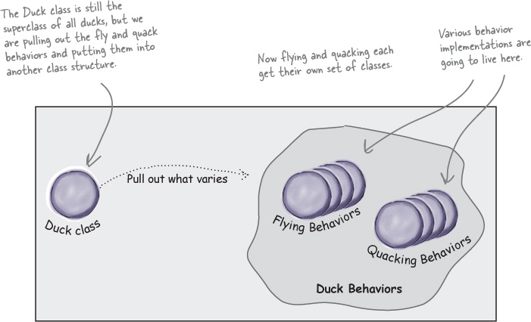
Strategy pattern

Slide 9
Strategy pattern
interface IStrategy is
method execute(a, b)
class ConcreteStrategyAdd implements IStrategy is
method execute(a, b) is
return a+b
class ConcreteStrategySubtract implements IStrategy is
method execute(a, b) is
return a-b
class context is
Strategy: IStrategy;
method executeStrategy(int a, int b) is
return strategy.execute(a, b)

Slide 10
Strategy pattern
class ExampleApplication is
method main() is
Create context object.
Read first number.
Read last number.
Read the desired action from user input.
if (action == addition) then
context.setStrategy(new ConcreteStrategyAdd())
if (action == subtraction) then
context.setStrategy(new ConcreteStrategySubtract())
result = context.executeStrategy(First number, Second number)
Print result

Slide 11
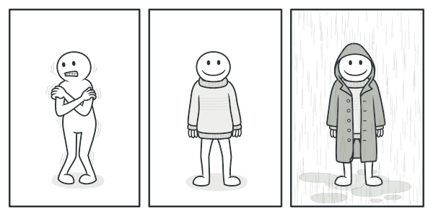
Decorator pattern (Wrapper class)

Slide 12
Decorator pattern (Wrapper class)
class OddOrEvenDecorator implements IStrategy is
Private _strategy: IStrategy;
method executeStrategy(int a, int b) is
return strategy.execute(a, b)
method IsEven(int a) is
return a % 2 == 0;
method IsOdd(int a) is
return a % 2 != 0;

Slide 13
Decorator pattern (Wrapper class)
class ExampleApplication is
method main() is
Create context object.
Read first number.
Read last number.
Read the desired action from user input.
if (action == addition) then
context.setStrategy(new OddOrEvenDecorator (new ConcreteStrategyAdd()))
if (action == subtraction) then
context.setStrategy(new OddOrEvenDecorator (new ConcreteStrategySubtract()))
result = context. Strategy.IsOdd(First number)
Print result

Slide 14
Facade pattern

Slide 15
Factory method pattern

Slide 16
Factory method pattern
abstract class AbstractDialog is
abstract method createButton():Button
method render() is
Button okButton = createButton()
okButton.render()
class WindowsDialog extends AbstractDialog is
method createButton():Button is
return new WindowsButton()
class WebDialog extends AbstractDialog is
method createButton():Button is
return new HTMLButton()

Slide 17
Factory method pattern
class Application is
field dialog: AbstractDialog
method initialize() is
config = readApplicationConfigFile()
if (config.OS == "Windows") then
dialog = new WindowsDialog()
else if (config.OS == "Web") then
dialog = new WebDialog()
else
throw new Exception("Error! Unknown operating system.")
method main() is
this.initialize()
dialog.render()

Slide 18
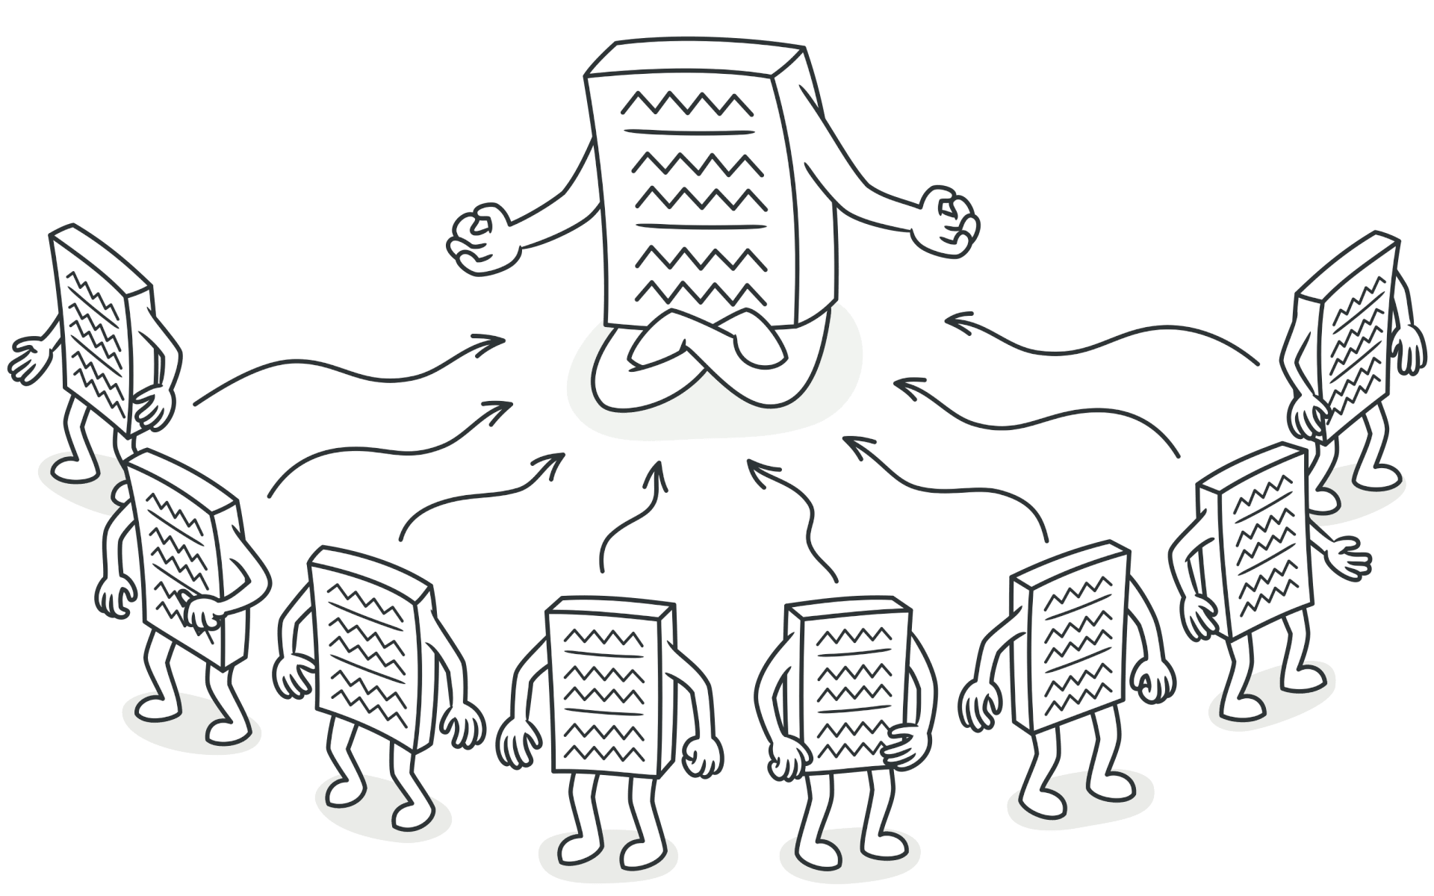
Singelton pattern

Slide 19
Singelton pattern
Class Database is
private static field instance: Database
private constructor Database() is
//Some Initiolization code
public static method getInstance() is
if (Database.instance == null) then
acquireThreadLock() and then
if (Database.instance == null) then
Database.instance = new Database()
return Database.instance

Slide 20
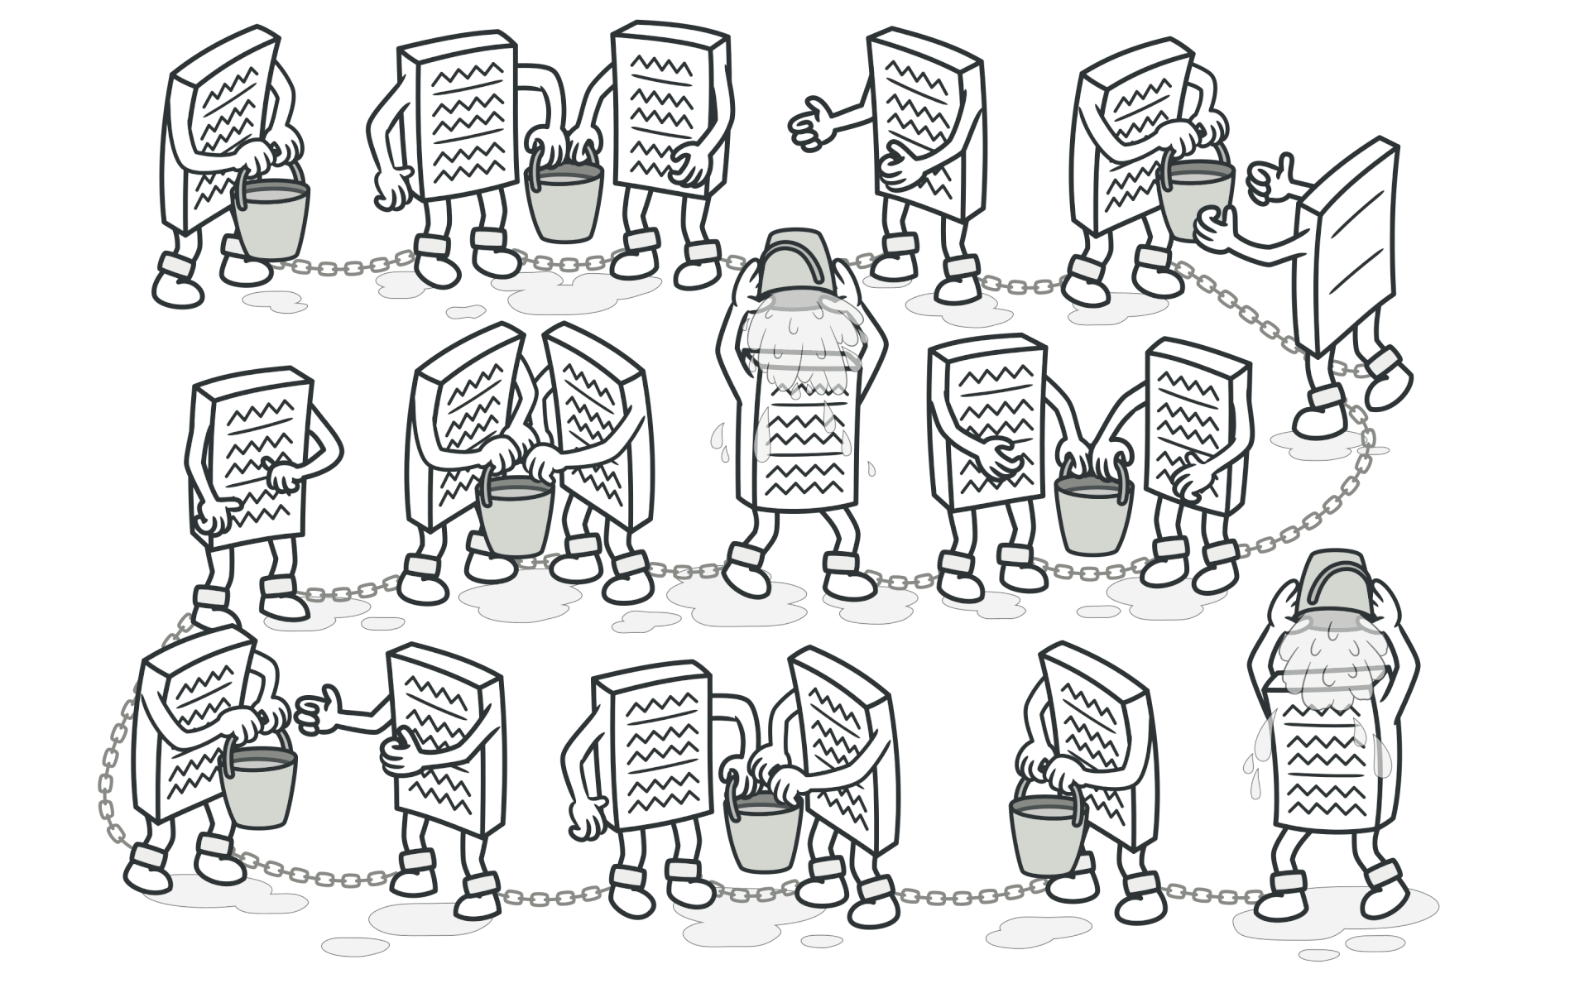
Chain of responsibility pattern

Slide 21
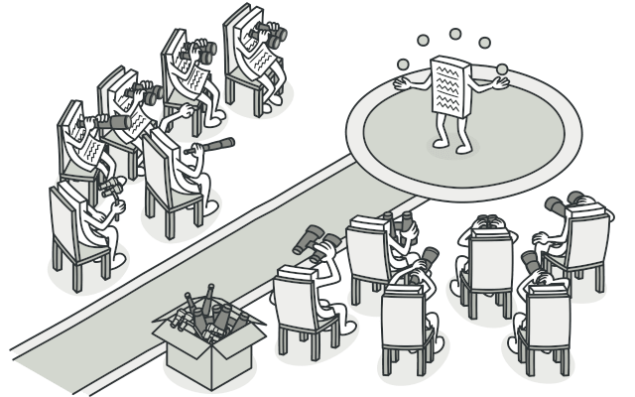
Observer pattern

Slide 22
Refrences
Why is OOP Such a Waste?. A waste of time of money. | by Ilya Suzdalnitskiy | Medium
Design Patterns (refactoring.guru)
Author, Eric Freeman & Author, Elisabeth Robson & Author, Bert Bates & Author Kathy Sierra (2004).Head First Design Patterns. Location: O'Reilly

